Slide 1


Bank of Baroda Hackathon - 2022
Technology Partner
Your Team Name :The cool Profs
Your team bio : We are a team of 4 members across academics and industy. Most of us are assistant professors at Presidency University
Date : 04/09/2022

Slide 2
Automated Cheque Processing(ACP)
Why did you use this problem statement ?
We, as an engineer are always passionate to build a product which can improve the life of the human race. As it was mentioned in the problem statement that BOB involves processing of large volumes of cheques which needs human intervention, thus increasing the processing time. The reason we chose to solve the problem are :
A common man problem : Banking affects the common man of India. Hence, the problem motivates us to contribute to the nation building.
Reduce human work : Many of our friends are working in banks and shares their stories of over work they faces in banks day to day. The technology will reduce the human efforts and will give the employee for focusing on their holistic development instead of such clerical jobs.
Passion to work on real time : Many of our team members have expertise in doing research in image processing . The problem statement gives us the opportunity to implement the learning for real time application.
Some advantage of ACP are
Making funds available faster;
Allowing quicker access to the digital image of their processed cheques; and
Detecting potential fraud sooner.
Bank handles large volumes of cheques in the clearing process. The process involves many technical verifications including signature verification. Some of these steps are manual and require human intervention to complete the process. The current process requires the high human capital deployment and longer processing

Slide 3
User Segment & Pain Points
Which user /advertiser segment would be early adopter of your product & why?
At present, many banks are having kiosk for automatic updation of passbook, dropping of cheques etc in their bank. On similar lines, we are aiming to build an automatic cheque processing kiosk for banks where user can interact with the machine, enter the basic details, submit the cheque and get a receipt of acknowledgment.
The cheque will get processed by the machine using OCR, image processing, AI and machine learning and will display a matching result to the user and will guide the user to action accordingly.
The early adopter of our product will be banks like BOB, SBI, BOI where the customer base is huge and a lot of human efforts are required to process the chques.

Slide 4
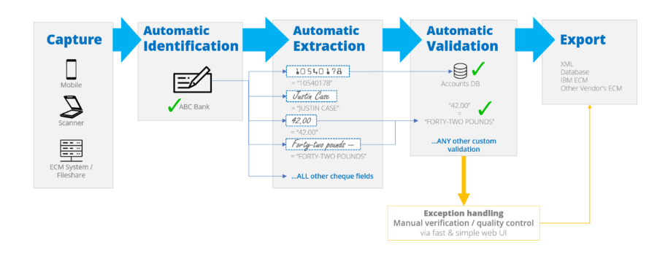
Azure tools or resources
Azure tools or resources which are likely to be used by you for the prototype, if your idea gets selected Ans : Figure below shows the flow chart of the process. Azure computer vision tool may be used for automatic extraction of hand written text .

Slide 5
Any Supporting Functional Documents
Present your solution, talk about methodology, architecture & scalability
When it comes to the clearance of the bank cheques and monetary transactions, this should not only be reliable and robust but also save time which is one of the major factor for the countries having large population. In order to perform the task of cheque verification, we developed a tool which acquires the cheque leaflet key components, essential for the task of cheque clearance using image processing and deep learning methods.
These components include the bank branch code, cheque number, legal as well as courtesy amount, account number, and signature patterns.
For this work, we will be using institute of development and research in banking technology (IDRBT) cheque dataset and deep learning based convolutional neural networks (CNN) for handwritten numeric character recognition. It is the state of art technology for precise assessment of the handwritten components of bank cheque.
For machine printed script, we will use MATLAB in-built OCR method. For verification of Signature we have used Scale Invariant Feature Transform (SIFT) and SSIM score for extraction of features and Support Vector Machine (SVM) as classifier.

Slide 6

Mehthodology
The bank cheque verification tool required fulfillment of some key stages in sequential manner. At first, the tool ensured the genuineness of IFSC present on cheque.
Then it verifies the cheque number to ensure whether the cheque was from the set of cheque leaflets assigned to the account holder or not.
After that, the amount will be verified by checking whether the customer was having sufficient amount in his account for which he released the cheque, and finally the signature of the cheque issuer(s) will be verified.
Only after the completion of these necessary verification steps, the cheque clearance was passed for transfer or withdrawal of funds.

Slide 7
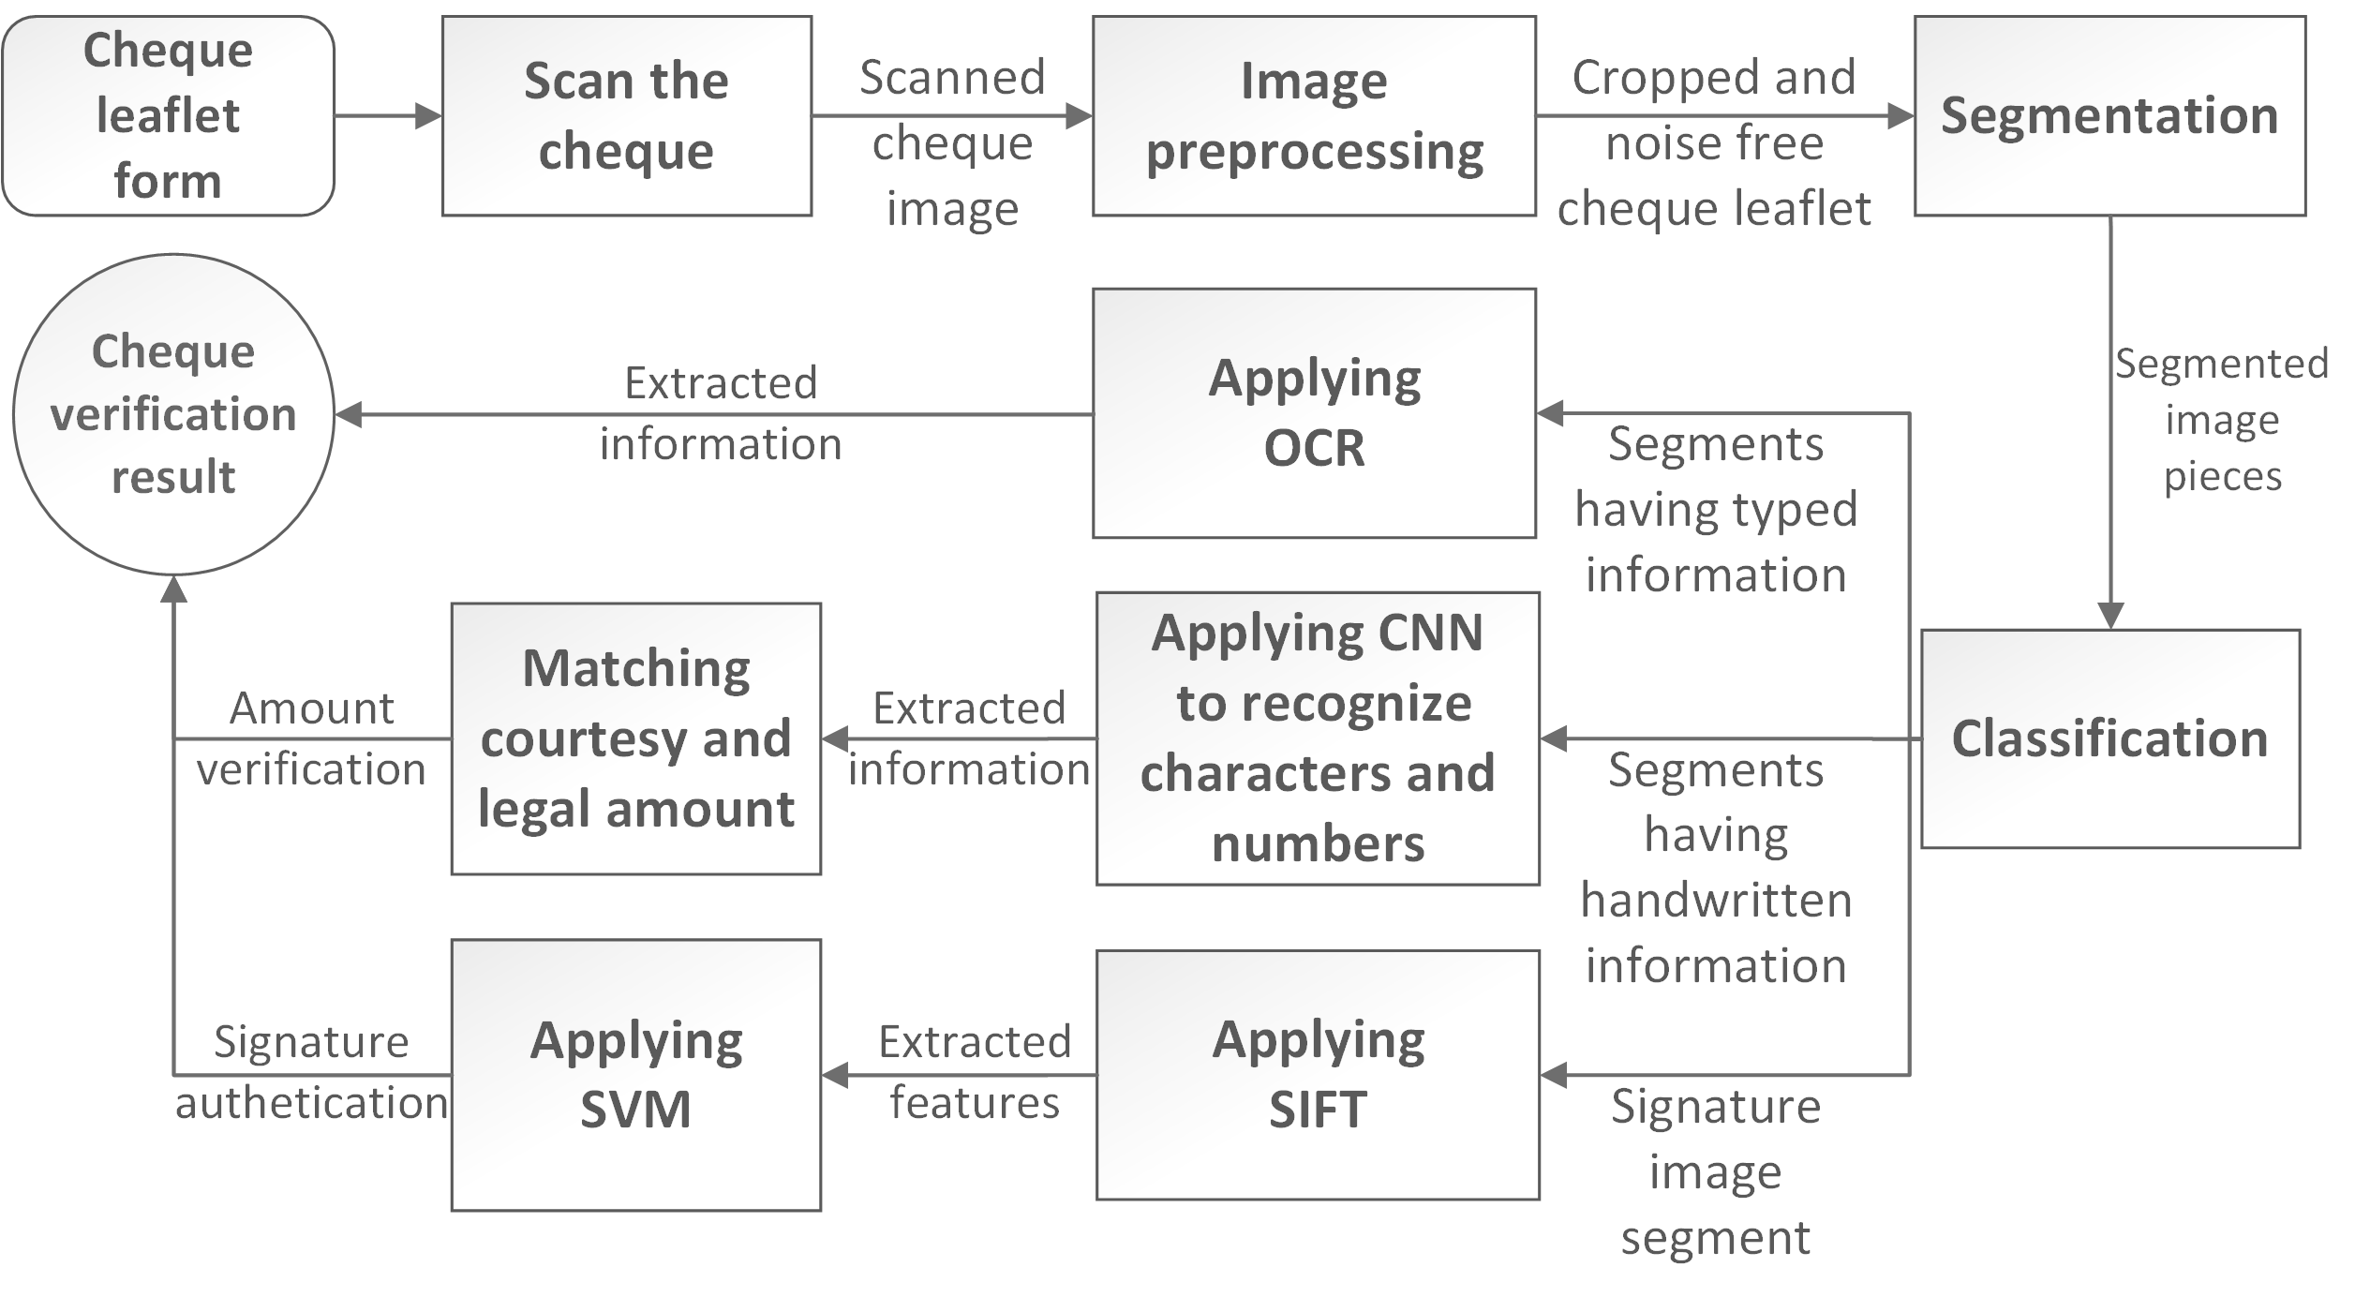
Block diagram

Slide 8
Image processing
Once the image is captured by the camera, the following operations are performend on the cheque.
Rotation : To correct the orientation of the cheques.
Removing background noise
Grayscale operation
Gaussian Filtering
Morphological operations
Segmentation

Slide 9
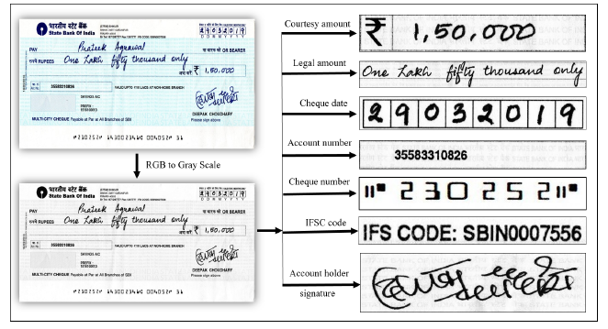
Sample Segmentation

Slide 10
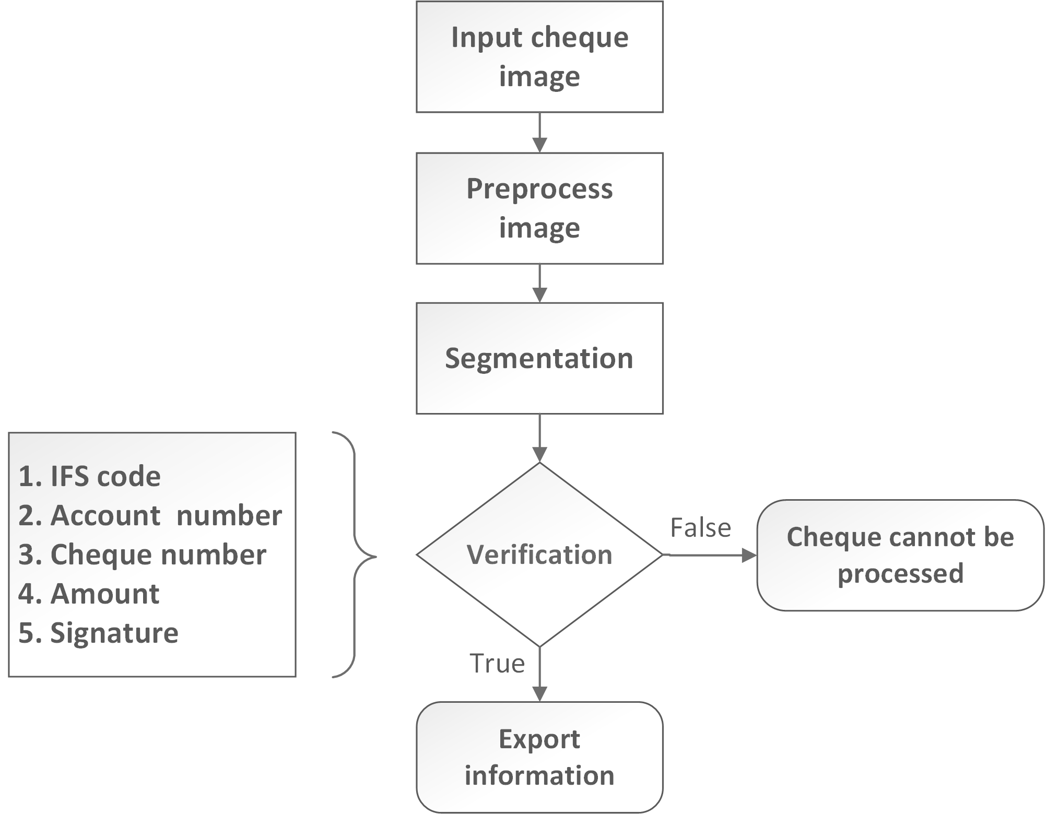
Flowchart

Slide 11
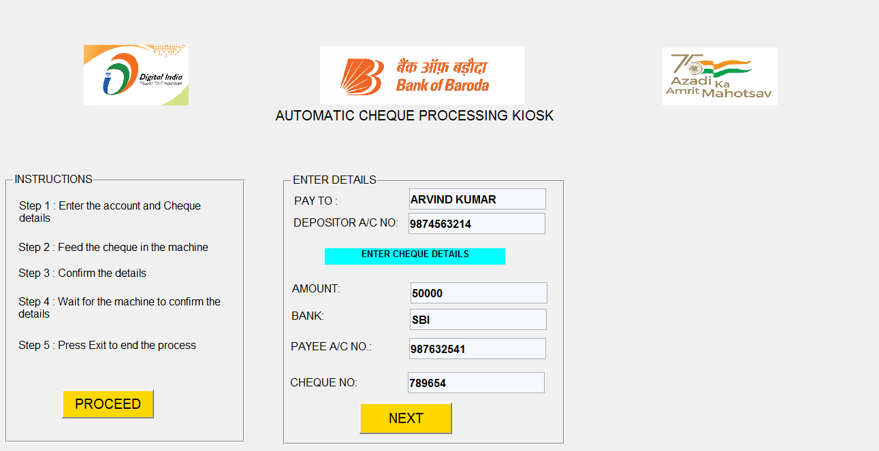
Developed GUI on MATLAB
User read the instruction and click on PROCEED.
User enter the basic details of the cheque manually and press NEXT. If there is some error/blank the machine will throw warnings.
Once the NEXT is pressed, the machine prompts the user to enter the cheque in the machine. The camera captures the images and verify the details like account number, chq number, amount, signature. Currently we have completed signature verification using SSIM Score.
STEP 1 AND 2

Slide 12
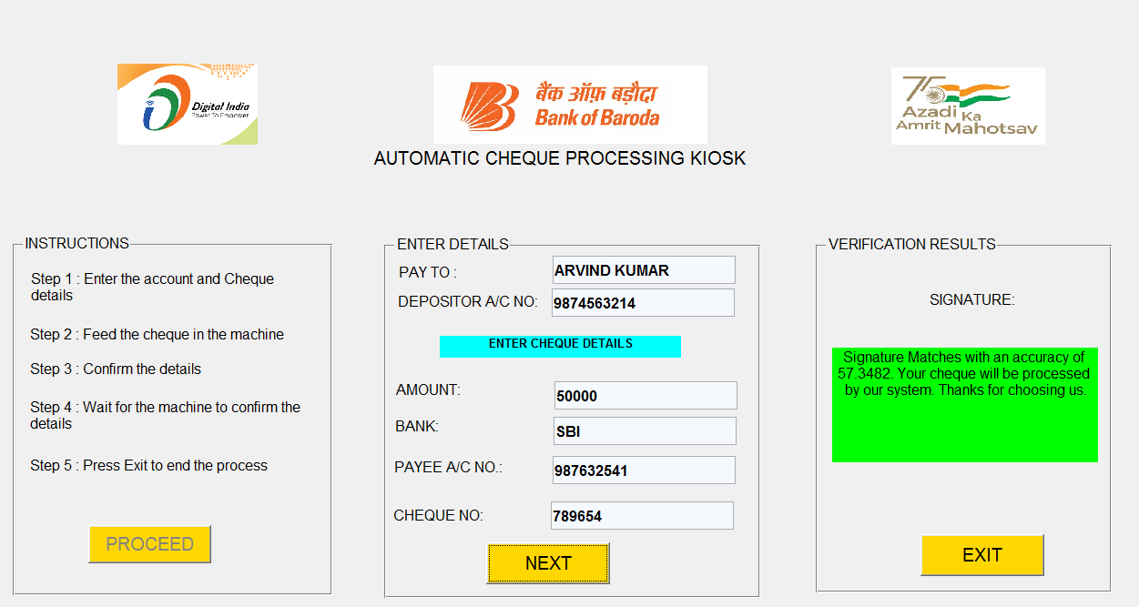
Developed GUI
We can change the threshold of signature matching score as per requirement for signature verification.
STEP 3

Slide 13
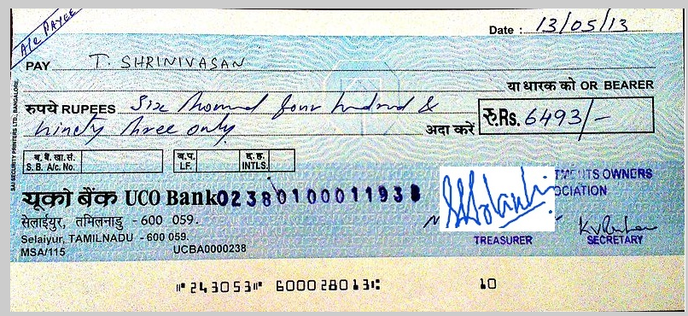
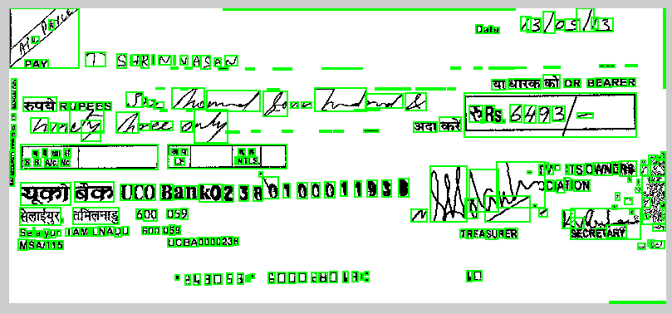
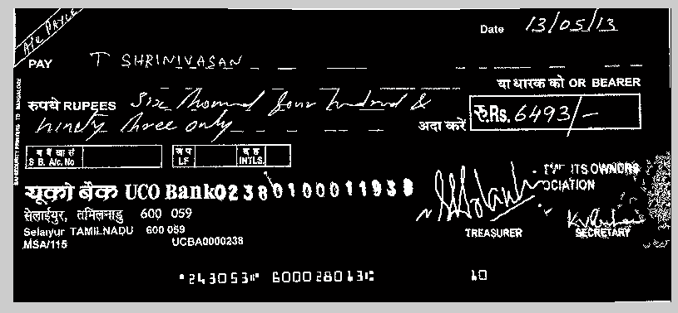
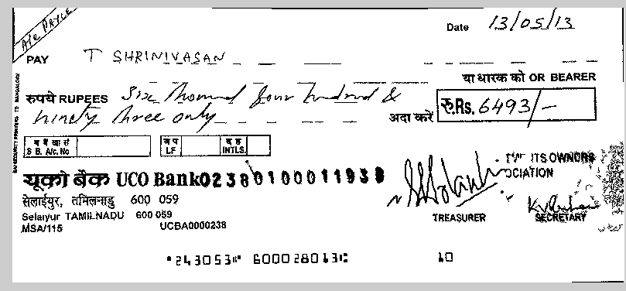
Some Results obtained from image processing of cheques

Slide 14
Key Differentiators & Adoption Plan
How is your solution better than alternatives and how do you plan to build adoption?
Most of the old methods proposed by researchers over the past are based on HMM, SVM, Wavelet, kNN, CNN etc to design their model with an accuracy of 75-99%. The advantage of this method over others are :
Efficient Image pre-processing
Ensure high accuracy(around 99%) by using different models for different task. Eg. CNN model for handwritten detection, SIFT and SSIM score for signature matching, OCR for printed text recognition.
The models can be extended to other languages by creating training and testing data in the native language and train the models again. The front GUI will remain same.

Slide 15
GitHub Repository Link & supporting diagrams, screenshots, if any
How far it can go?
We have already shared the screenshots in the previous slides.
Link for github https://github.com/arvind9835/dCoolProfs

Slide 16
Thank You
Arvind Kumar (Team lead)
Kiran Kale
Amarnath Mishra
Natya S

